Slide 1


Time Compare Unit Update
For Lockheed Martin
Design Review
March 01, 2019

Slide 2
The Lockheed Time Unit
Chris Tota (Logistics manager)
Connor Granaas (Design manager)
Rodney Rodriguez (Project manager)
Nate Kilmer (Communications / Finance manager)
Jacob Doyle (Test manager)
Customer: Rhett Rodewald (Lockheed Martin)
Faculty Advisor: Dr. Byeong Lee

Slide 3
Project Background
Customer:
Specializes in
Global Aerospace
Defense
Security
TCU Solution
To aid in satellite and ground station communication
Besides the device I/O, team will focus on the unit itself, disregarding the future environment at LM.
(since 1995)

Slide 4

Problem statement
Time Compare Unit Functionality
Receive two 1pps signals from coax
Compute Δt, minimum accuracy 100ns
Output Δt over ethernet
Satellite
Time Compare Unit
Satellite Signal
Client Computer
Coax Cable
-Computes
Δt = t_{gr} - t_{sat}
-Outputs Δt
Δt
Ground
Station
Receive and Display
Ethernet
Reference Signal
Coax Cable

Slide 5
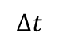
Timing Diagram
Voltage (V)
Signal 1 (Reference Signal)
1s
5
0
Time (s)
Voltage (V)
$$∆t$$
Signal 2 (Satellite Signal)
~1s
5
0
Time (s)

Slide 6
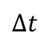
Timing Diagram
Voltage (V)
Signal 1
5
0
Time (s)
Voltage (V)
$$∆t$$
Signal 2
5
0
Time (s)

Slide 7
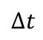
Timing Diagram
Voltage (V)
Signal 1
5
0
Time (s)
Voltage (V)
$$∆t$$
Signal 2
5
0
Time (s)

Slide 8
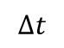
Timing Diagram
Voltage (V)
Signal 1
5
0
Time (s)
Voltage (V)
$$∆t$$
Signal 2
5
0
Time (s)

Slide 9
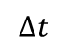
Timing Diagram
Voltage (V)
Signal 1
5
0
Time (s)
Voltage (V)
$$∆t$$
Signal 2
5
0
Time (s)

Slide 10
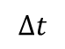
Timing Diagram
Voltage (V)
Signal 1
5
0
Time (s)
Voltage (V)
$$∆t$$
Signal 2
5
0
Time (s)

Slide 11
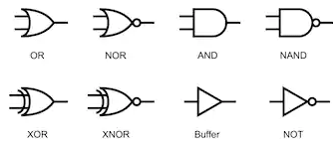
Changes to Proposal
Platform has been selected
Team has chosen to no longer pursue the FPGA or Sampling approach.
A logic latch-timer method has been selected
Other than selecting a design method
The team’s proposal has remained the same

Slide 12
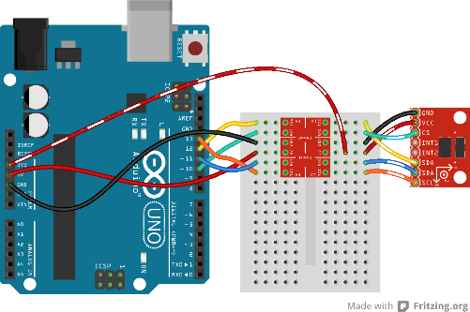

Changes to Requirements
Team must now consider
The TCU outputting a ∆t = 0 (picoseconds)
Two signals coming in at the same time
Solution
The team plans to account for this change in the software that will be uploaded to the micro controller.
Software
Hardware

Slide 13
Existing Specifications
Constraint | Unit | Minimum | Typical | Maximum
Operating Temperature | °C | 15 | 20 | 30
Cost | $ | - | - | 5000
Input High | V | 4.5 | 5.0 | 5.5
Input Low | V | -0.5 | 0 | 0.5
Input Pulse Width(Ground) | μs | 90 | 100 | 110
Input Pulse Width(Satellite) | μs | 19.99 | 20 | 20.01

Slide 14
Existing Specifications
Constraint | Unit | Minimum | Typical | Maximum
Supplied Power | V | 11.5 | 12 | 12.5
Rise Time | ns | - | - | 50
Calculation Time | s | - | - | 1

Slide 15
Changes to Specifications
SAM E70 - IwIP
Logical Components
OCXO Oscillator
- ECOC-2522

Slide 16
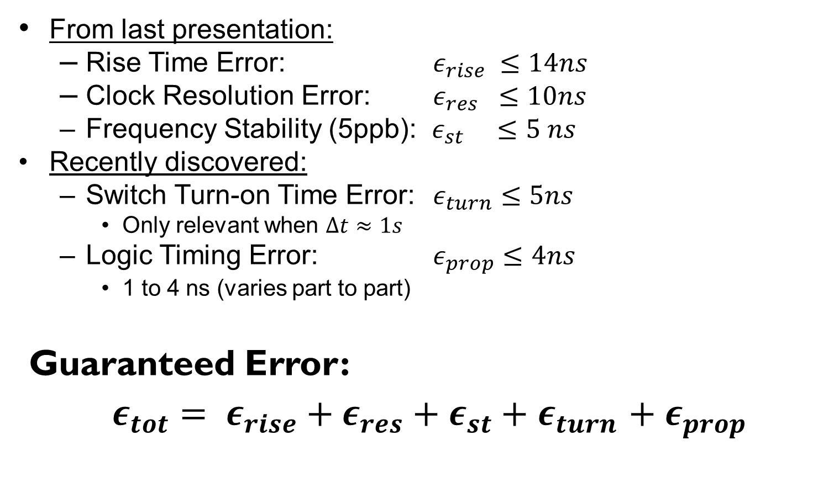
Timing Errors
From last presentation:
Rise Time Error: $ε_{rise} ≤14ns$
Clock Resolution Error: $ε_{res} ≤10ns$
Frequency Stability (5ppb): $ε_{st} ≤5 ns$
Recently discovered:
Switch Turn-on Time Error: $ε_{turn}≤5ns$
Only relevant when $∆t≈1s$
Logic Timing Error: $ε_{prop}≤4ns$
1 to 4 ns (varies part to part)
Guaranteed Error:
$ε_{tot}= ε_{rise}+ε_{res}+ε_{st}+$ $ε_{turn}$ $+ ε_{prop}$

Slide 17
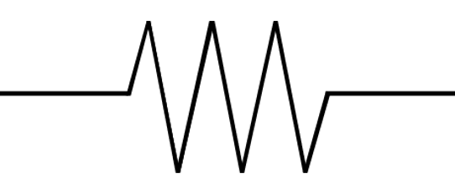

Time Compare Unit - Design
Basic Functionality:
Clock
Micro-
Controller
Signal 1
$$∆t$$
Latch
System
Signal 2
Counter 1
Calibration
Latch
System
Counter 2

Slide 18
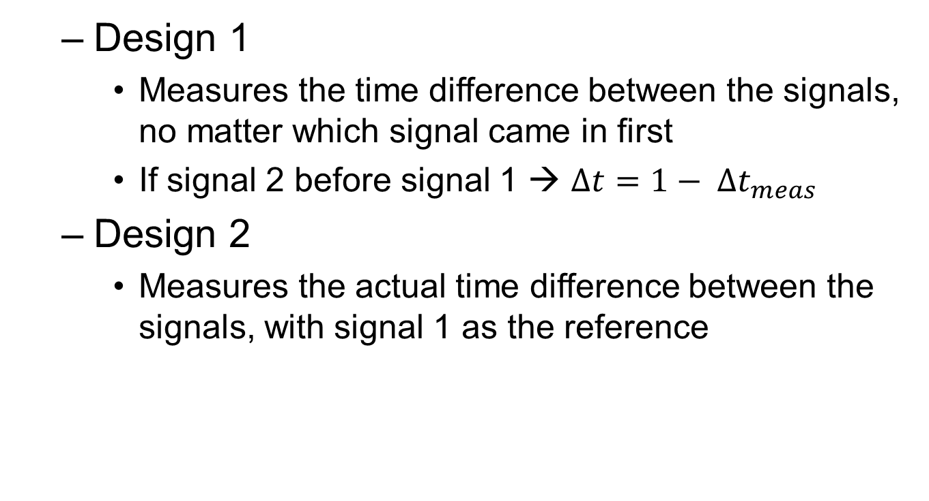
Design Implementations
Design 1
Measures the time difference between the signals, no matter which signal came in first
If signal 2 before signal 1 → $∆t=1− ∆t_{meas}$
Design 2
Measures the actual time difference between the signals, with signal 1 as the reference

Slide 19
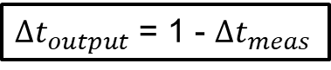
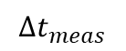
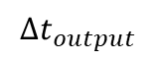
Design 1
Voltage (V)
$∆t_{output}$ = 1 - $∆t_{meas}$
Signal 1
5
0
$$∆t_{meas}$$
Time (s)
Voltage (V)
Signal 2
$$∆t_{output}$$
5
0
Time (s)

Slide 20
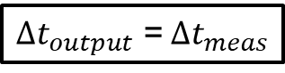
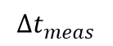
Design 2
Voltage (V)
$∆t_{output}$ =$∆t_{meas}$
Signal 1
5
0
Time (s)
Voltage (V)
$$∆t_{meas}$$
Signal 2
5
0
Time (s)

Slide 21
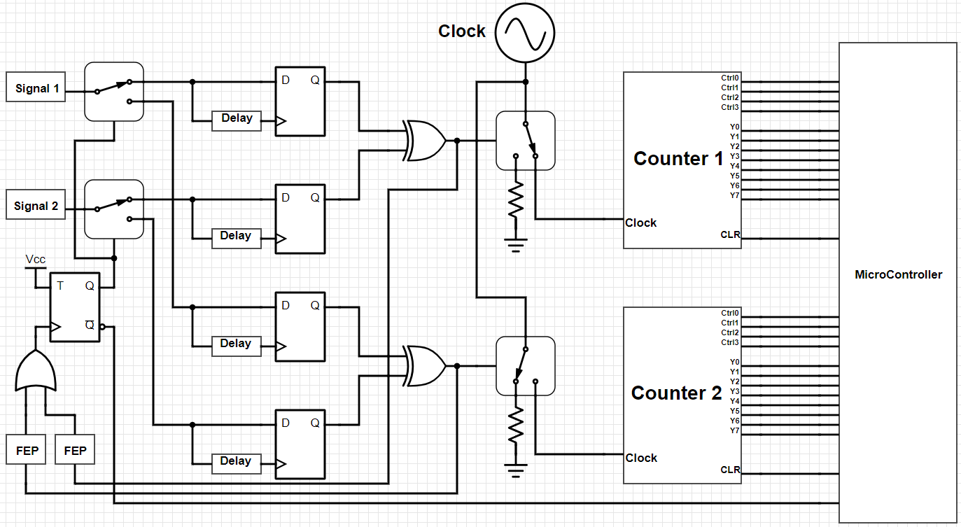

Design 1 - $∆t$ Measurement Circuit
Delay = 10ns
FEP = Falling Edge Pulse

Slide 22
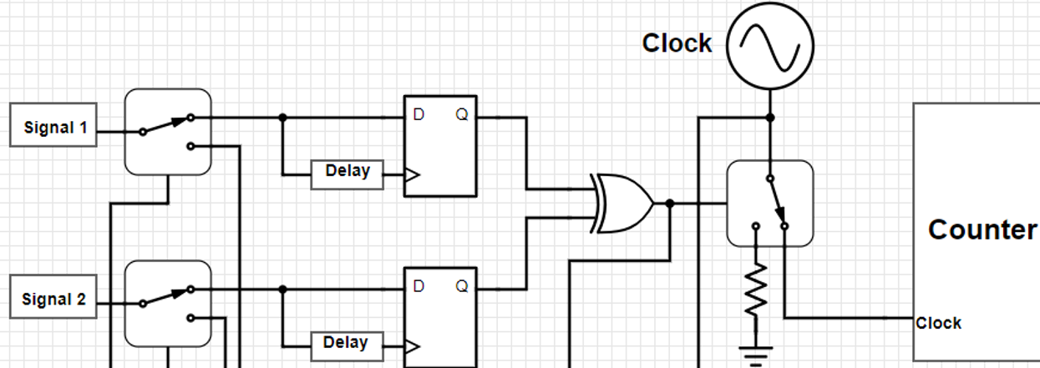
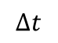
Design 1
Switch
Control
Voltage (V)
5
Signal 1
0
Voltage (V)
5
$$∆t$$
Signal 2
0
Voltage (V)
5
Switch Control
0

Slide 23
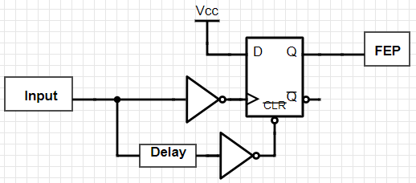
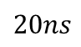
Falling Edge Pulse (FEP) Circuit
Delay = 20ns
Voltage (V)
5
Input
Voltage (V)
$$20ns$$
5
Q

Slide 24
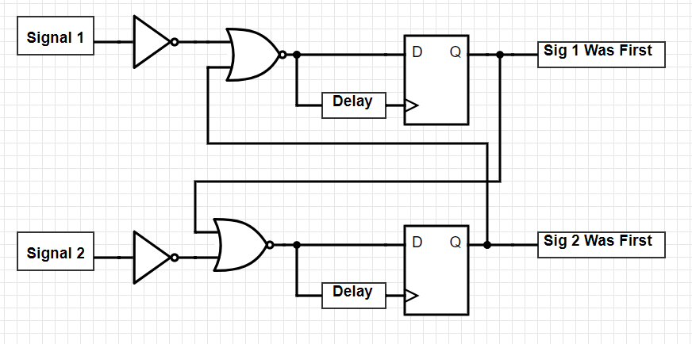
Design 1 - Did Signal 2 Come in First
Delay = 10ns

Slide 25
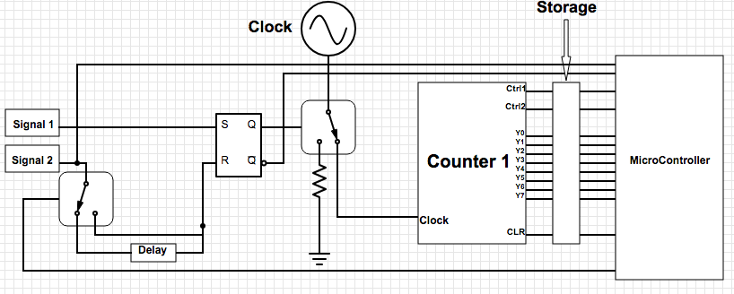
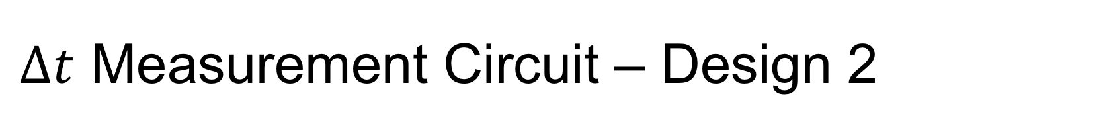
$∆t$ Measurement Circuit – Design 2
Delay = 10us

Slide 26
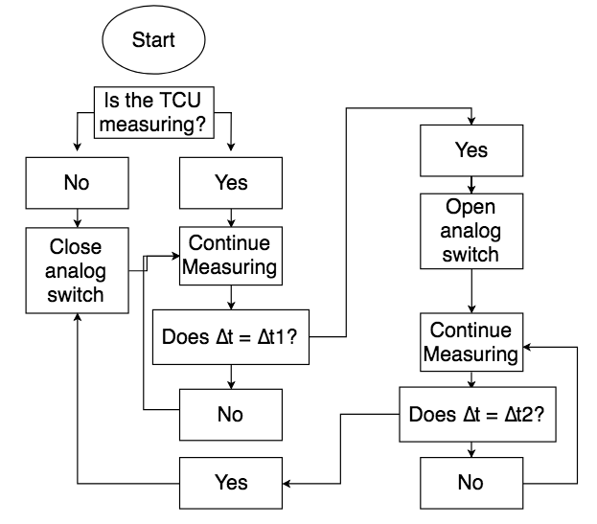
Design 2 Methodology

Slide 27
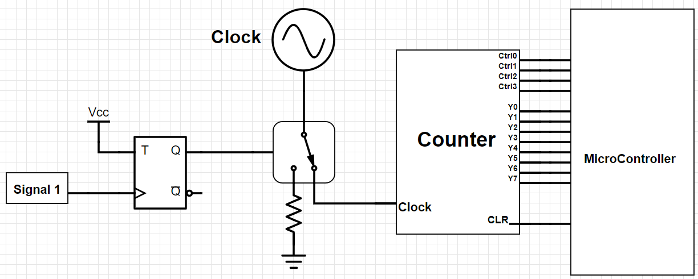
Design 1 & 2 - Calibration Circuit
Calibration every 2 seconds

Slide 28
Pros & Cons
 | Pros | Cons
Design 1 | No counter value storage | An additional counter
 | No missed counts | More components
 | Meets specifications
Design 2 | Fewer components | Counter value storage
 | Less switching delay | Possible missed counts
 | Meets specifications

Slide 29
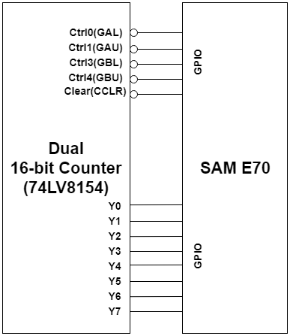
Microcontroller-Hardware Interface
74lv8154 contains two 16-bit counters
Counters will be cascaded to achieve 32 bits
Counter data is accessed by byte through 4 control lines (one-hot encoding)

Slide 30
Measurement Buffering
Measurement completes at any point in 1Hz cycle
May leave little room for reading counters
Counter output will have to be buffered
Active-high
count ready
$$Measurement complete$$
$$Start new measurement$$
Time (s)
0
1

Slide 31
Oscillator Calibration
Ground station provides a consistent 1pps that will act as a reference
This Ground Station signal is at the top of the calibration hierarchy
Calibration is performed through a counter that increments on every OCXO clock pulse
Calibration counter is read every other pps

Slide 32
Oscillator Calibration
$$calibration factor=\frac{nominal calibration count}{measured calibration count}$$
$$Δt=calibration factor ∗measured delta count$$
Oscillator Output
Measured Rate
9 cycles
Nominal Rate
10 cycles
Time (ns)
50
100

Slide 33
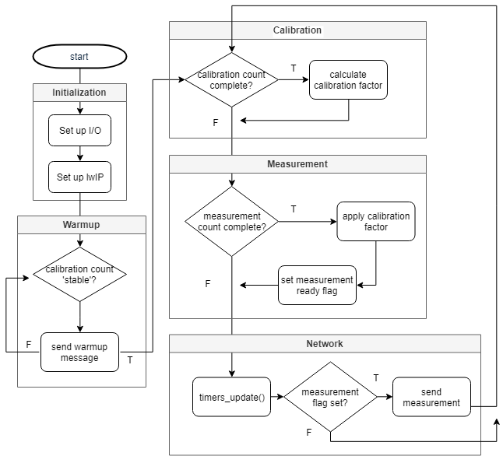
Software Flowchart
Initialization
Set up the µC I/O and TCP/IP stack
Warmup
Wait for OCXO to stabilize Calibration
Read calibration counter, calculate calibration factor Measurement
Read measurement counter, apply calibration factor
Network
Send the measurement to the client

Slide 34
Hardware Characteristics
Testing components individually
Need to characterize how individual components respond to inputs
Slowly piece together unit, maintaining desirable characteristics
Translate complete unit to solderable breadboard once a functional unit is assembled

Slide 35
Testing Plan: Concept
Produce a series of known deltas
Two signal sweep
Set sig1 to 1Hz
Set sig2 to 0.99Hz → deltas increase by 10,101,010ns
e.g. Δt₁=10,101,010ns, Δt₂=20,202,020ns, Δt₃=30,303,030ns, etc.
Compare measured deltas to predicted values

Slide 36
Testing Plan: Equipment
Produce a series of known deltas
Keysight 33622A
High-stability timebase: 0.1ppm stability
Low jitter: ~1ps jitter
Low harmonic distortion: ~0.03%
Pulses up to 100MHz
Keysight MSOX6004A Oscilloscope
Agilent N2894-60002 Passive Probe
700MHz

Slide 37
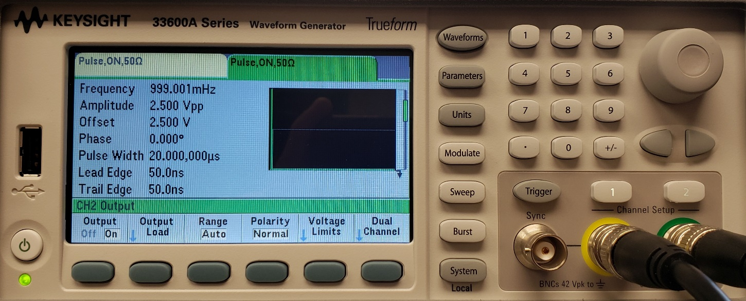
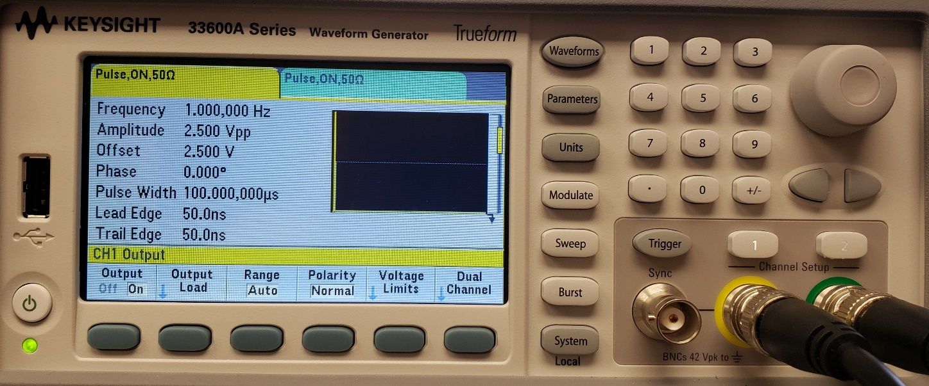
Testing Plan: Equipment

Slide 38
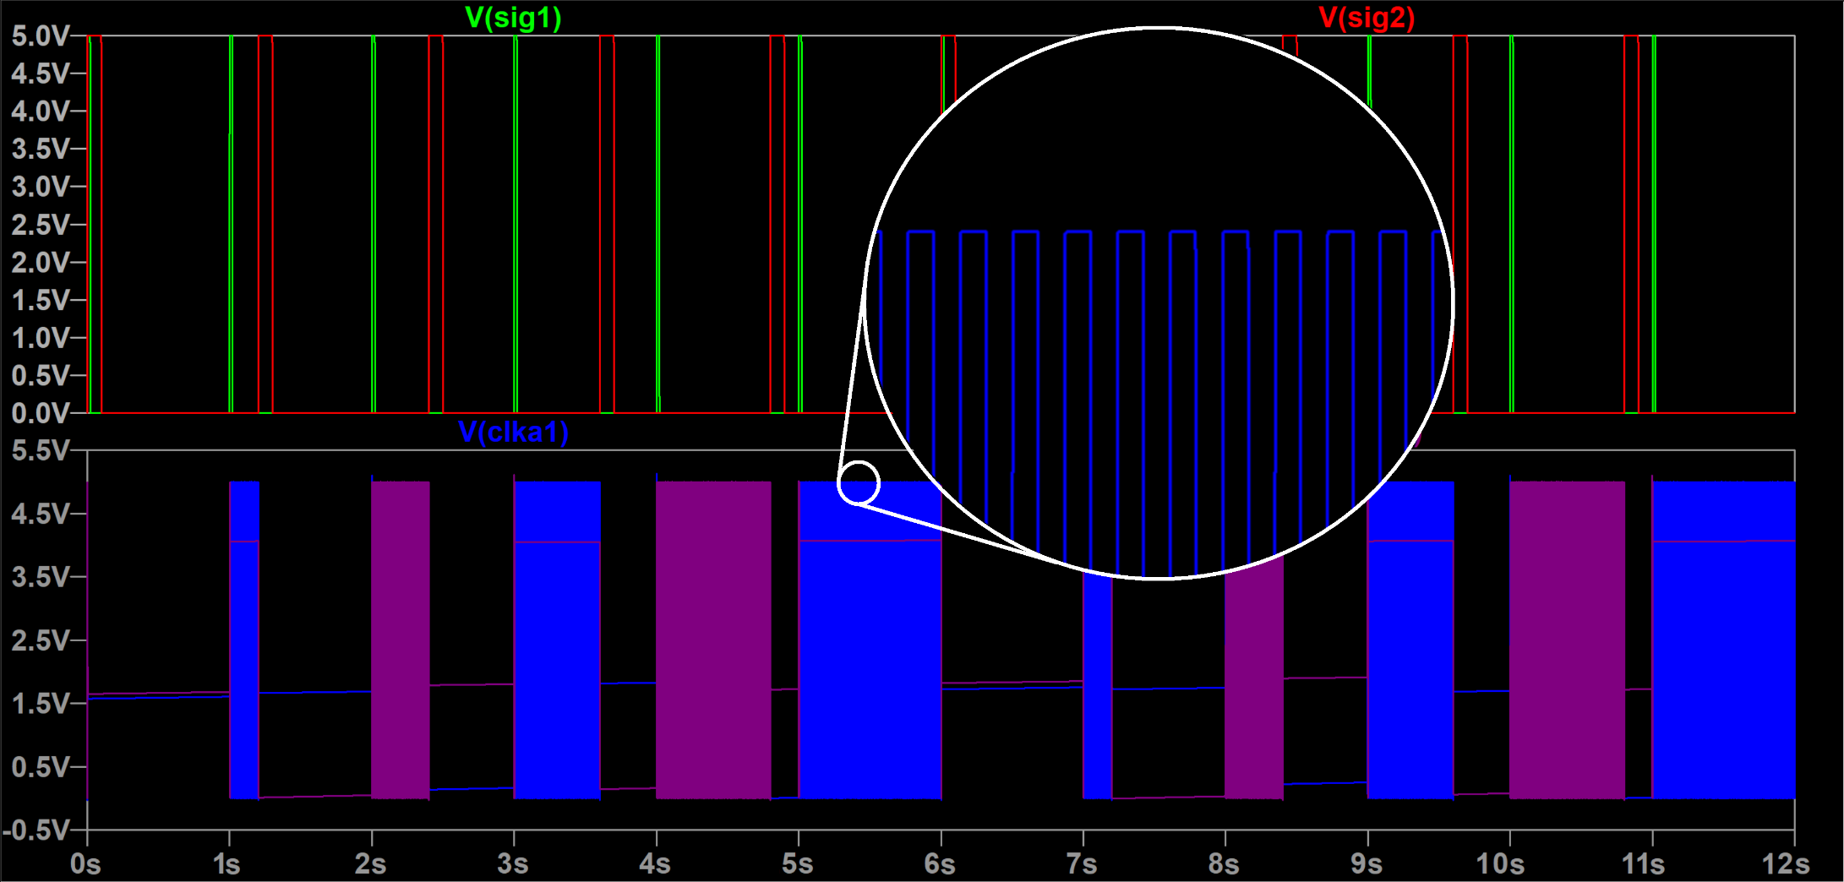
Testing Plan: Expected Results

Slide 39
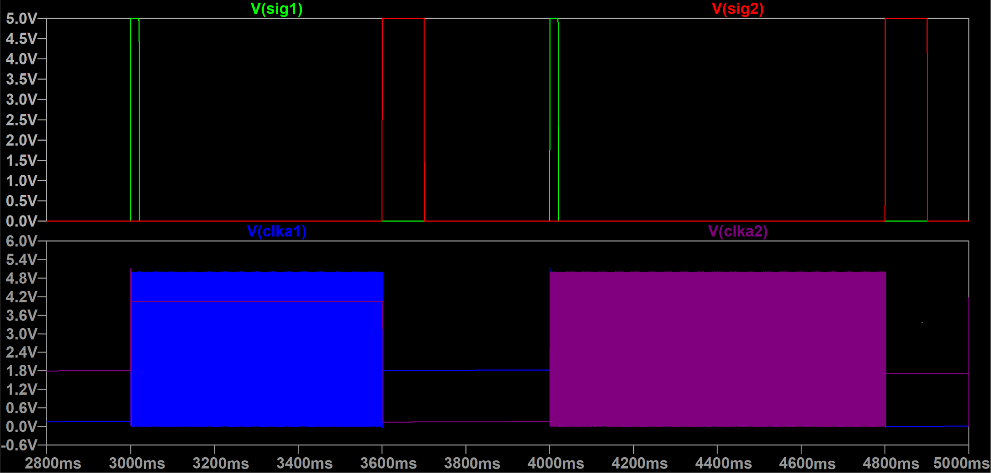
Testing Plan: Expected Results

Slide 40
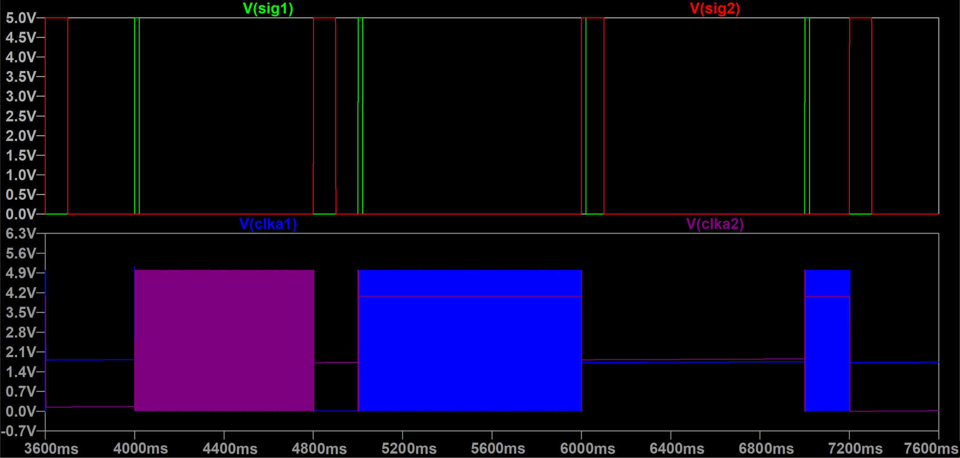
Testing Plan: Expected Results

Slide 41
Testing Plan: Live Demo
Live Stress Tests
Conduct series of specifically designed, troublesome scenarios
Predict measurement values
Confirm the integrity of our measurements

Slide 42
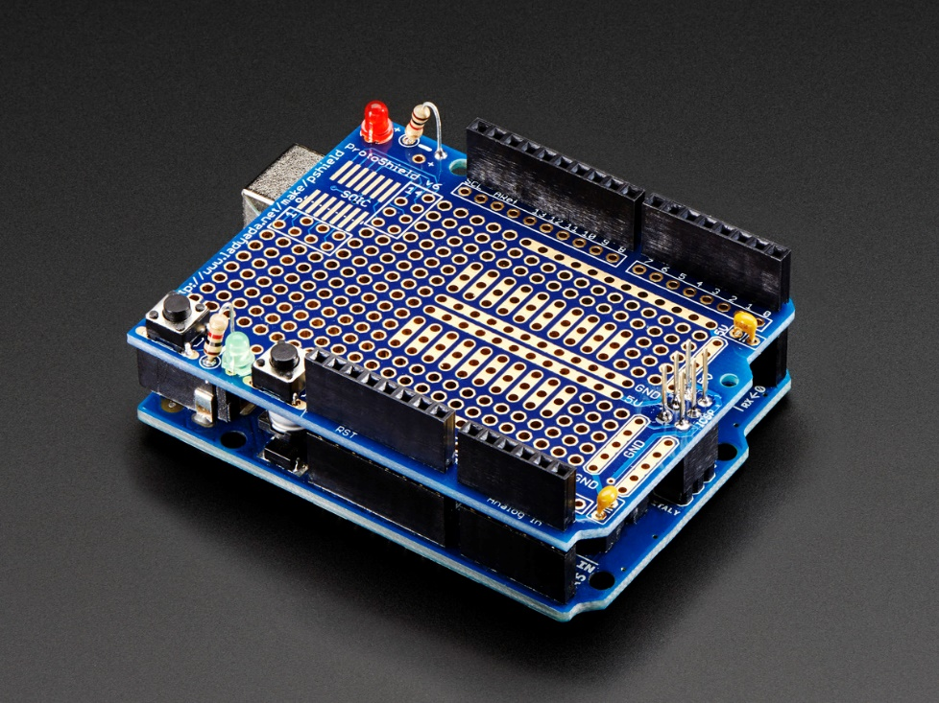
Deliverables: Hardware
SAM E70 headers mechanically compatible with Arduinio
Hardware will rest on shield above the SAM E70 board

Slide 43
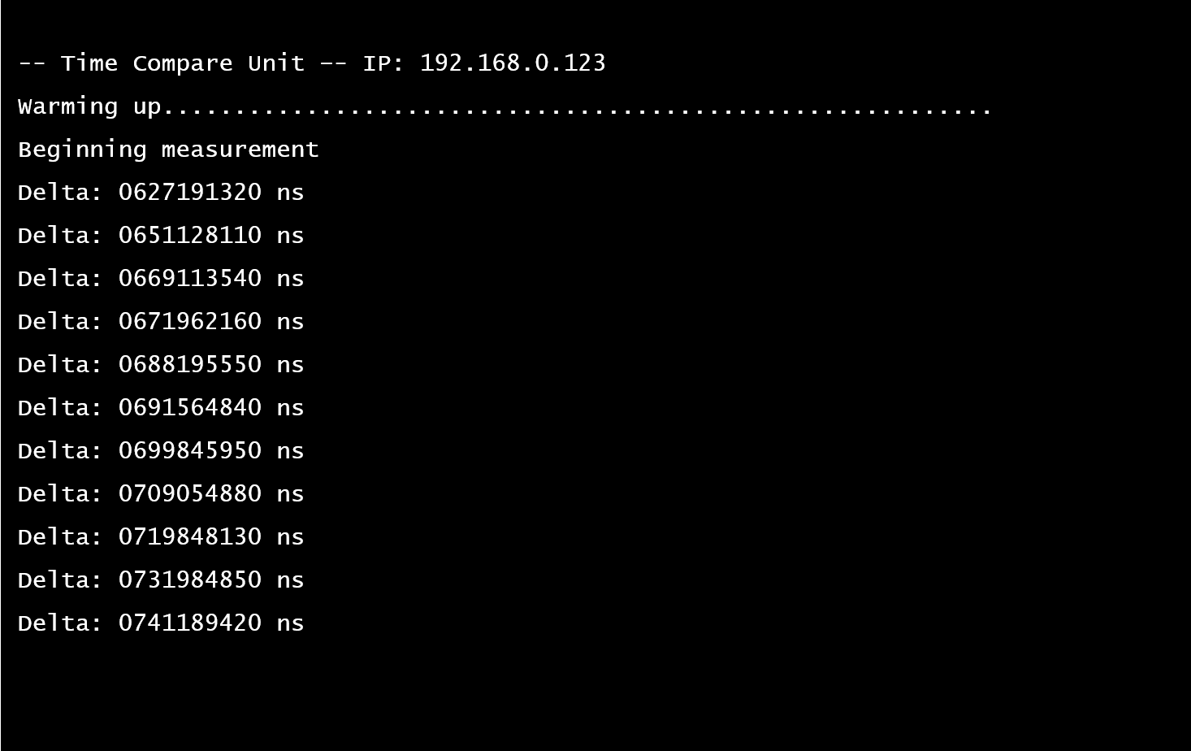
Deliverables: Software
Data is presented through a telnet client
Delta will be reported in 10’s of nanoseconds
Typical measurement message is a 22-byte ASCII string
Point-to-point network

Slide 44
Integrated Course Knowledge (Review)
Course Number: | Course Name: | Reason:
ECE 1411 & 2411 | Logic Circuits I & II | Logic gates and digital circuits
ECE 2205 & 3205 | Circuits and Systems I & II | Introduction to passive components and AC/DC circuit analysis
ECE 3210 & 3230 | Electronics I & II | Introduction to active components in AC/DC analysis
ECE 3430 | Intro to Microcomputer Systems | Interfacing with software driven hardware (μC’s)
ECE 4510 | Feedback Control Systems | Simulation modelling (software)

Slide 45
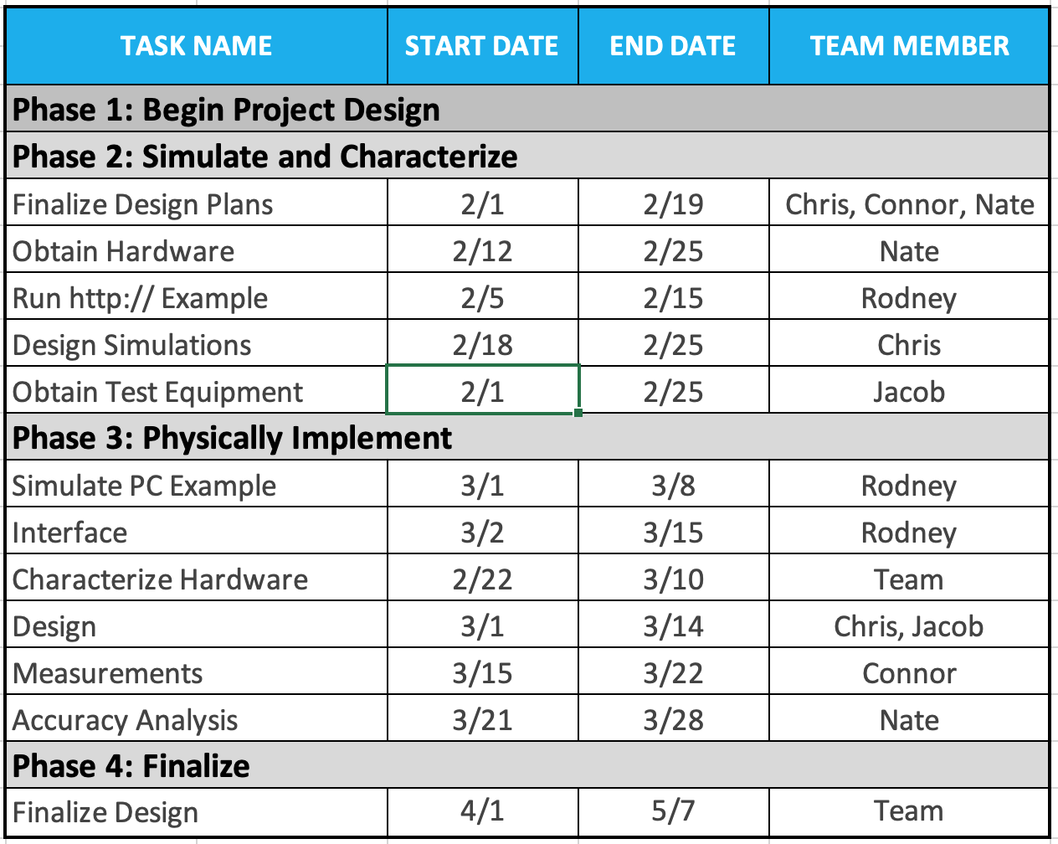
Gantt Chart Table

Slide 46
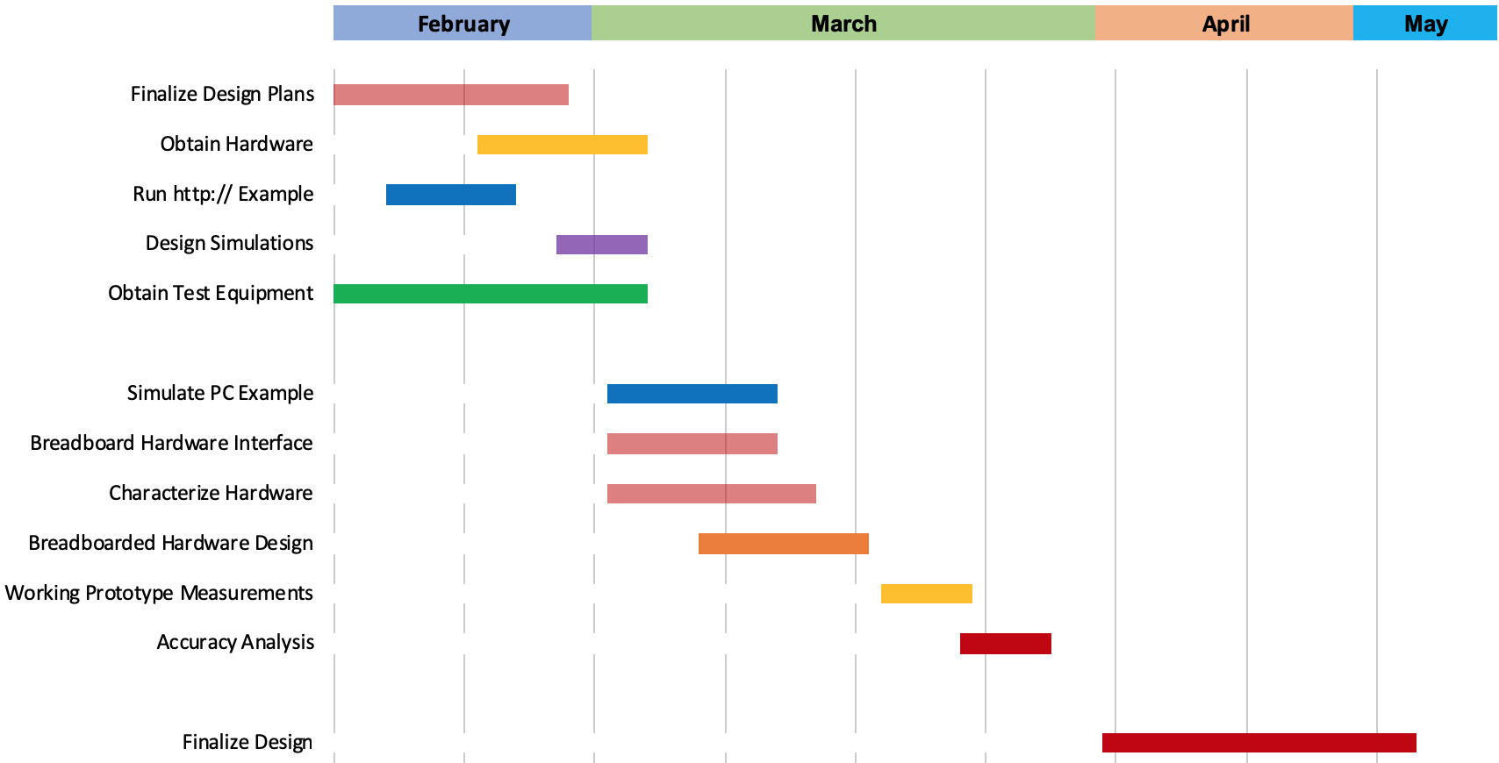
Gantt Chart

Slide 47
Project Budget $5000
Component | Part Number | Qty. | Unit Cost | Total
100MHz Oven Controlled Oscillators | ECOC-2522 | 2 | $116.68 | $233.36
SAM E70 Microcontroller | ATSAME70-XPLD | 1 | $40.83 | $40.83
JK Flip Flops | SN74F109N | 15 | $0.779 | $11.69
D Flip Flops | 74AC11074N | 15 | $1.895 | $28.43
SR Latches | SN74LS279AN | 15 | $1.174 | $17.61
32-bit Counters | SN74LV8154 | 15 | $1.090 | $16.35
XOR Gates | SN74AHC86N | 15 | $0.341 | $5.12
NOR Gates | SN74AS02N | 15 | $2.210 | $33.15
Inverters | SN74F04N | 15 | $0.559 | $8.39
SPDT Switches | TS5A9411DCKR | 10 | $0.545 | $5.45
Surface Mount to Through Hole Mounts | AN0002 | 10 | $2.690 | $26.90
Solderable Breadboards | PRT-12699 | 4 | $8.950 | $35.80
Shipping/Tax: |  |  |  | $60.32
TOTAL: |  |  |  | $523.40
$5000 - $523.40 = $4476.60 Remaining

Slide 48
Summary
- LTU is on track to deliver a working prototype of the time compare unit
-The team plans on finishing hardware characterization and system prototyping to move to finalization stages

Slide 49

Thank You
Are there any questions?

Slide 50
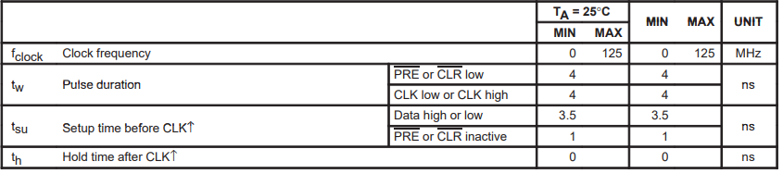
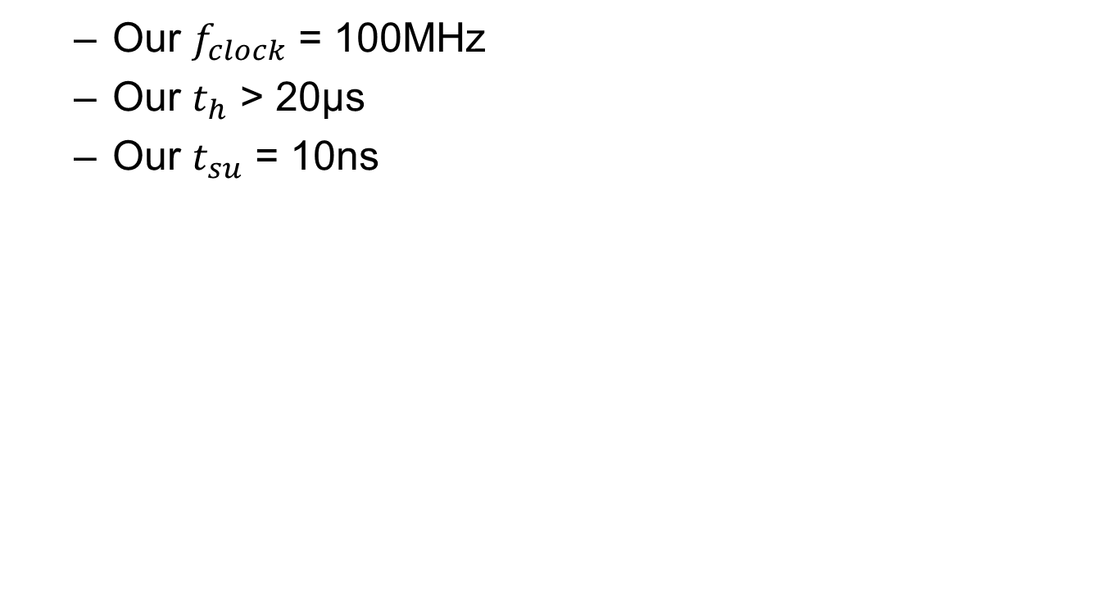
Setup/Hold Time for Design 1
Our $f_{clock}$ = 100MHz
Our $t_{h}$ > 20µs
Our $t_{su}$ = 10ns

Slide 51
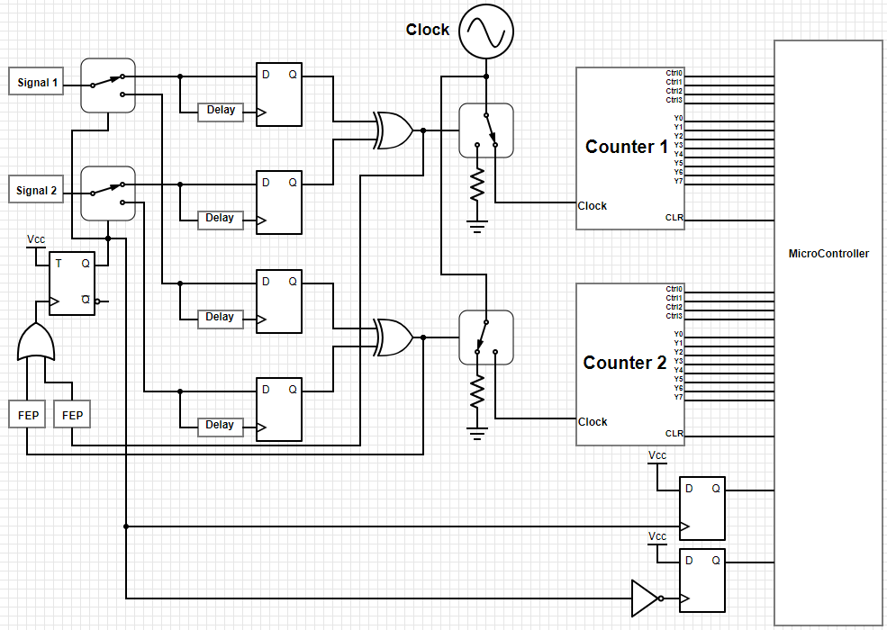
Design 1 Expanded

